Slide 1
Land Cover and Land Use Change In Mount Lebanon
SURV695B– Master Thesis
Bassem Naser Aldine
Bassem.nad@gmail.com

Slide 2
Outline
Background and overview
Objective
Methodology
Statistical Analysis
Results and Discussions
Conclusion

Slide 3
Background
Monitoring and detecting the changes of land use and land cover of the earth’s surface is extremely important to achieve and maintain continual and precise information about study area for any kinds of planning of the development.
Geographic information system (GIS) and remote sensing technologies have shown their great capabilities to solve the study issues like land use and land cover changes.
The aim of this thesis is to produce data in form of maps and statistics of land use and land cover of Mount-Lebanon Area (Aley, Souk Al-Ghareb, Bmakine, Ain-Remmeneh, and Qmatieh) over 18 years period (2005-2022) to monitor the possible changes that may occur particularly in urban or built-up land, agricultural land and forestry Land.
In this study, CORINE classification and supervised classification were the major classifications approach to provide classified maps, and four land use and land cover categories were identified and mapped.

Slide 4
Methodology
Two methods or systems for land cover/use classifications were used in this study. The Corine Land Cover classification system and the supervised classification system.
Each system will be examined alone taking into account the criteria and classifiers used in deriving subclasses.

Slide 5
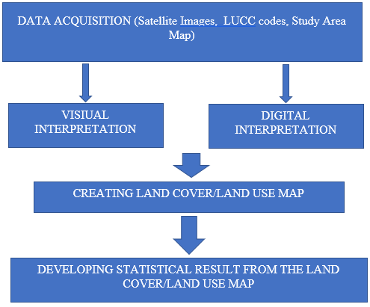

Slide 6
DATA ACQUIRED AND SOURCE:
For the CLC study, IKONOS, base-map, and SAS satellite data of Lebanon were acquired for three years namely, 2005, 2017 and 2022 respectively.
The 2005 image has a resolution of 1m, while 2017 and 2022 images have a resolution of 30 cm.
Moreover, for the supervised land cover study, multispectral LANDSAT satellite data of Lebanon were acquired for same years namely, 2005, 2017, and 2021.
All the LANDSAT images have resolution of 30 meters.
SOFTWARE USED IN THIS THESIS:
ARCGIS 10.3 - This was used for classification by digital and visual interpretation and to create the land cover/ land use pattern.
GOOGLE EARTH – This was used as an aid for the visual interpretation to get a clearer image of the scene under investigation.
EXCEL- This was used to create and develop statistical results for the LUCC using graphs and tables.

Slide 7
CLC Classification of Study Area at Level 4
The steps followed for analysis are:
a- Digitization of different classes using polygon tool.
b- displaying all the different classes in the same layer.
c- calculating area of each class.
First, IKONOS satellite image of 2005 was first added to the ArcMap and an editing session was started at a scale of 1/20,000.
Then we started delineating the polygons according to CORINE nomenclature adopted for Lebanon at level 4, while taking into consideration the minimum representative area in the land cover/land use map is 10,000 square meters.
Later on, after the delineation was finished and the attribute table was filled, a sum of the area of the classified types at level 4 was measured and calculated.

Slide 8
CLC Classification of Study Area at Level 1
The following steps were used to translate the CLC maps created at level 4 to level 1:
Selecting classes by the mean of attribute.
Merging the selected classes in an editing session into one class that correspond to each category:
Artificial Area.
Agricultural Area.
Wooded Land.
Unproductive Area.
Later, after the translation was completed, areas were calculated and maps were produced for each year.

Slide 9
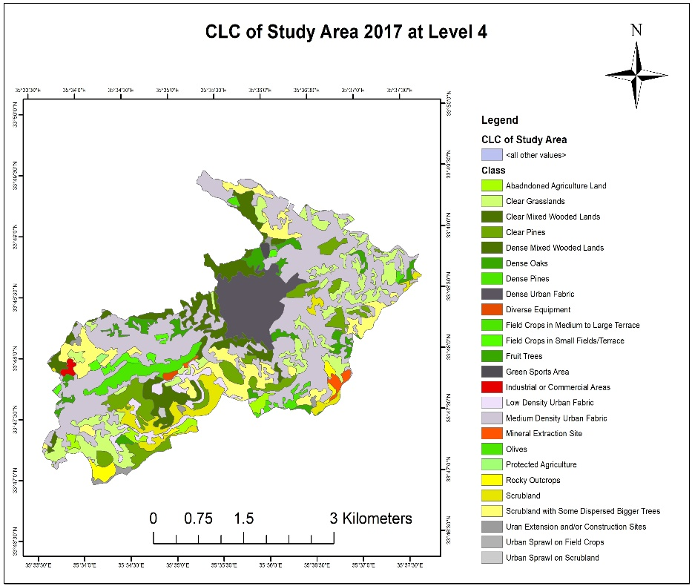

Slide 10
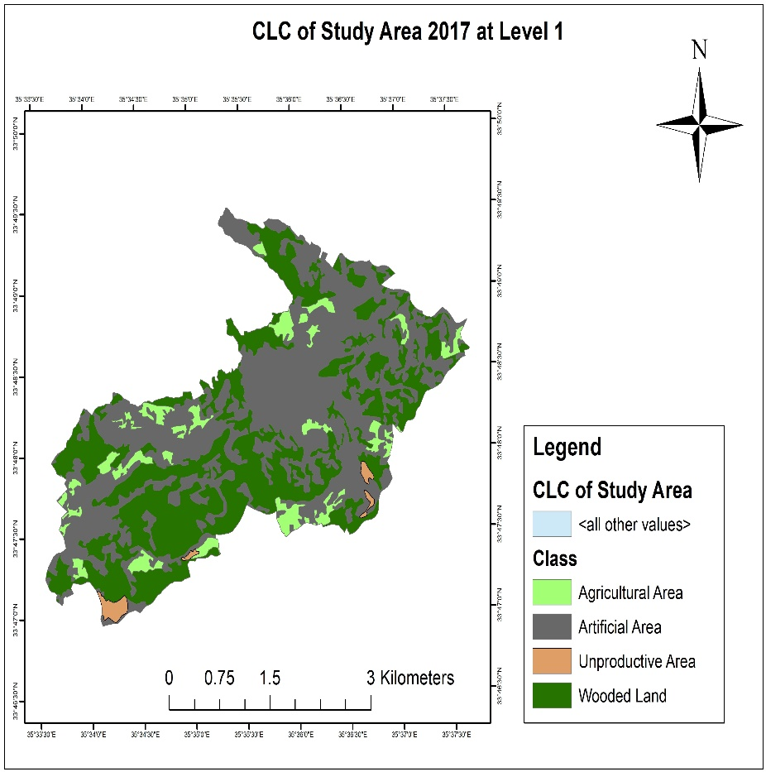

Slide 11
CLC classification of each village at level 1
In this step, clipping the CLC of study area at level 1 using village area of interest was applied and maps were created for all villages in the study area:
Aley
Qmatieh
Bmakine
Souq Al-Ghareb
Ain-Remmeneh

Slide 12
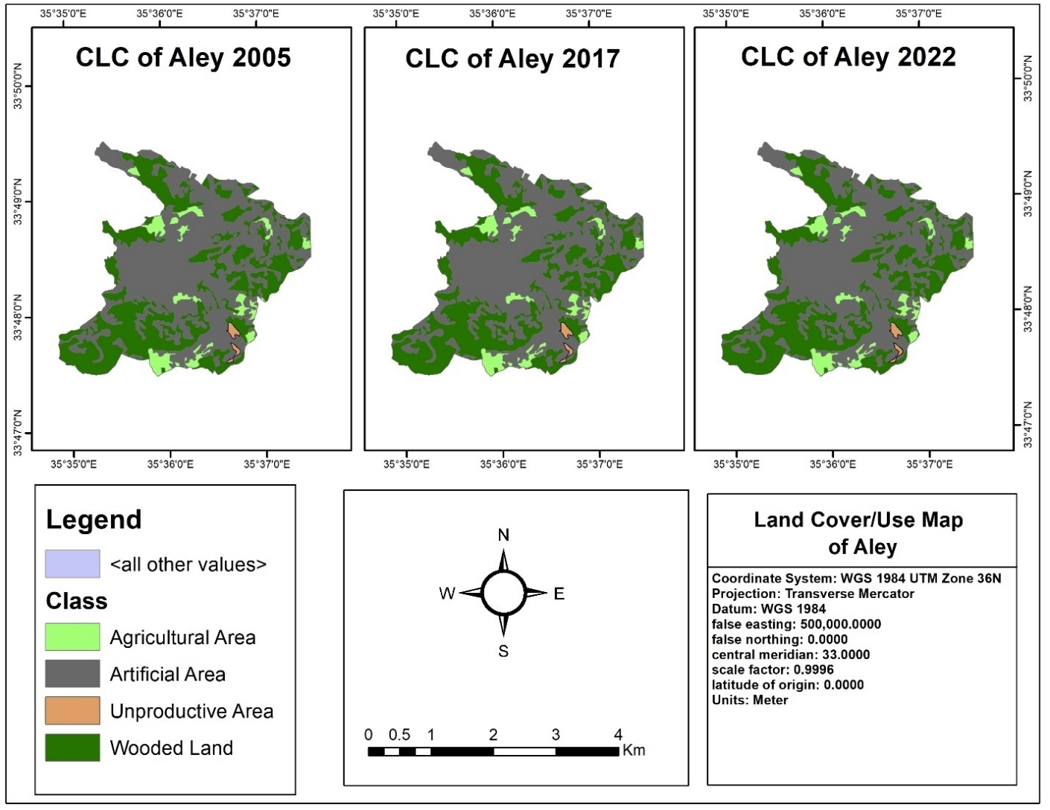

Slide 13
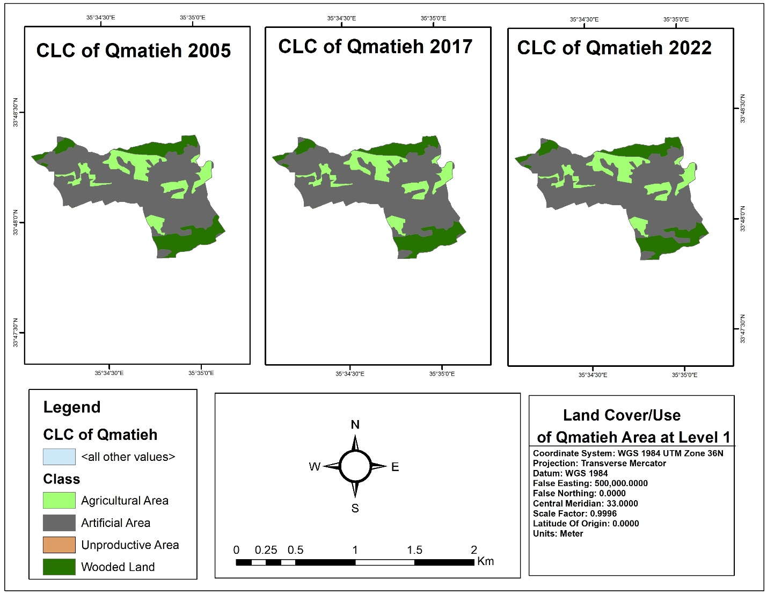

Slide 14
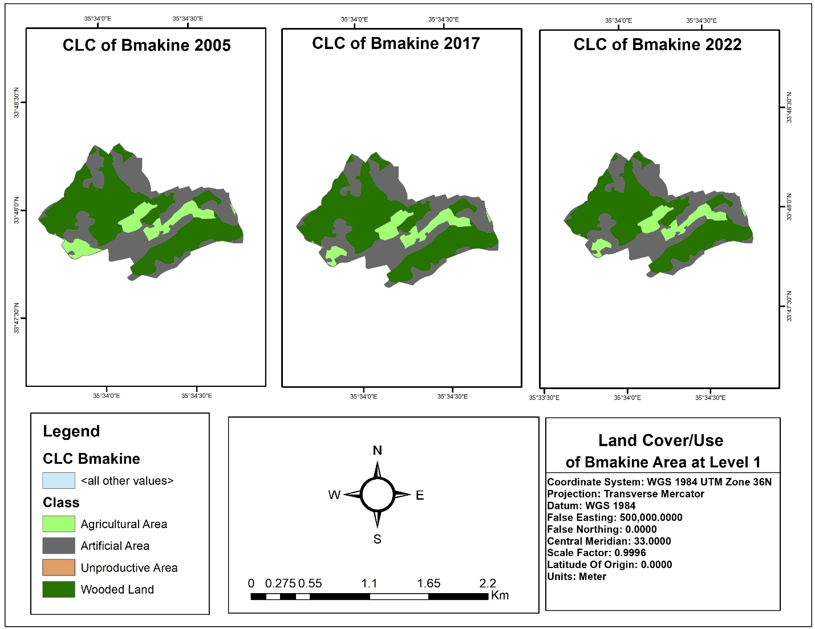

Slide 15
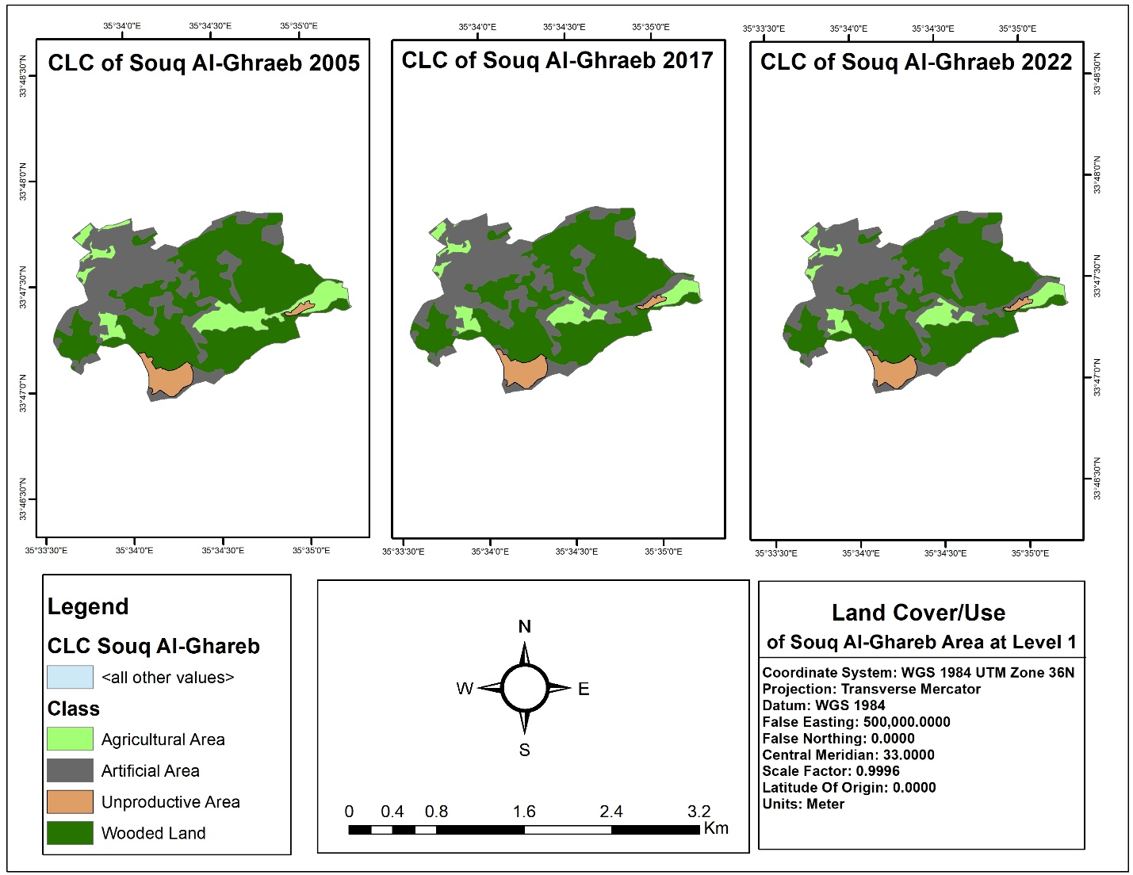

Slide 16
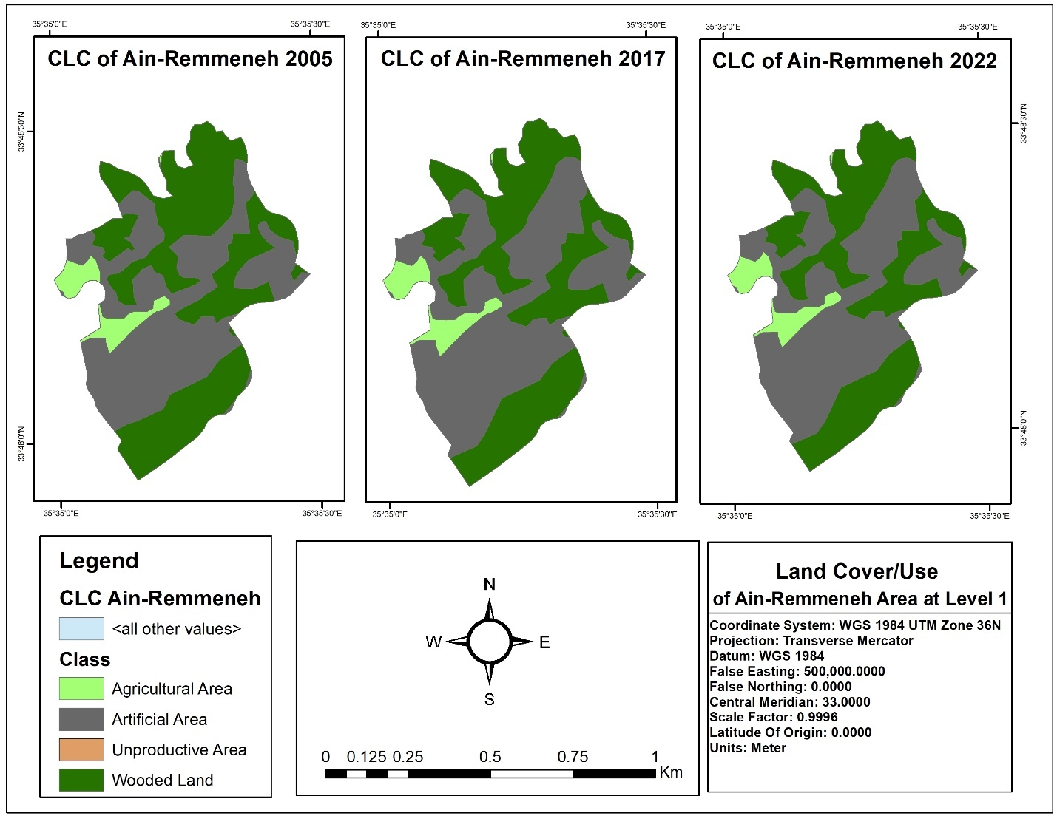

Slide 17
Limitation of this study
The major limitation of the study is that the resolution of all the three images is not the same.
The 2005 image has a resolution of 1m whereas the 2017 and 2022 images have a resolution of 30cm.
Therefore, accuracy of results yielded from 2005 image is less than that from 2017 and 2022 image.

Slide 18
supervised classification
The procedure followed by supervised classification is categorizing all pixels in a digital image into different land use / land cover classes.
Depending on the interaction between computer and interpreter during classification process.
Using this method, an image is classified using spectral signatures (i.e., reflectance values) obtained from training samples (polygons that represent distinct sample areas of the different land cover types to be classified)

Slide 19
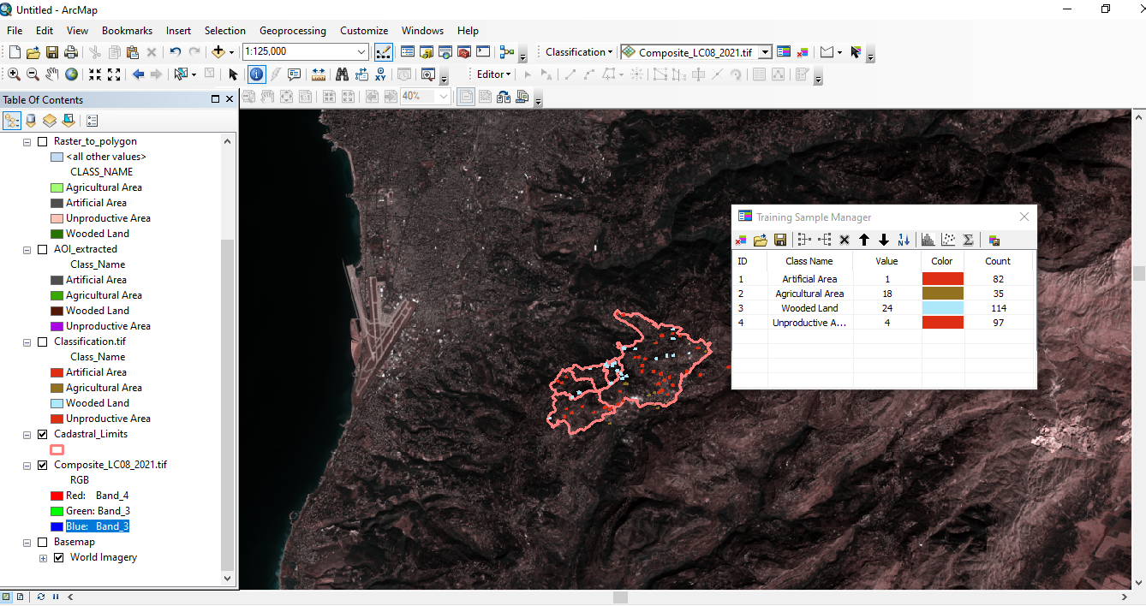

Slide 20
LUC comparison between Corine and supervised classification
A translation method was applied to CLC maps created at level 4 to transform them into level 1.
This method was done using dissolving and editing tool in order to match the classes with the LUC supervised maps.
Finally, results were extracted for both systems and compared using tables and graphs.

Slide 21
results and discussion
study area
The study area chosen for testing purpose lies between 33 48’ 31” to 33 49’ 36” N and longitude 35 37’ 39” to 35 43’ 33” E.
It is a part of Mount-Lebanon area which includes the villages of Aley, Souq Al-Ghareb, Qmatieh, and Bmakine.
These villages are almost 23 km away from Beirut city and the average elevation is 650m above mean sea level.

Slide 22
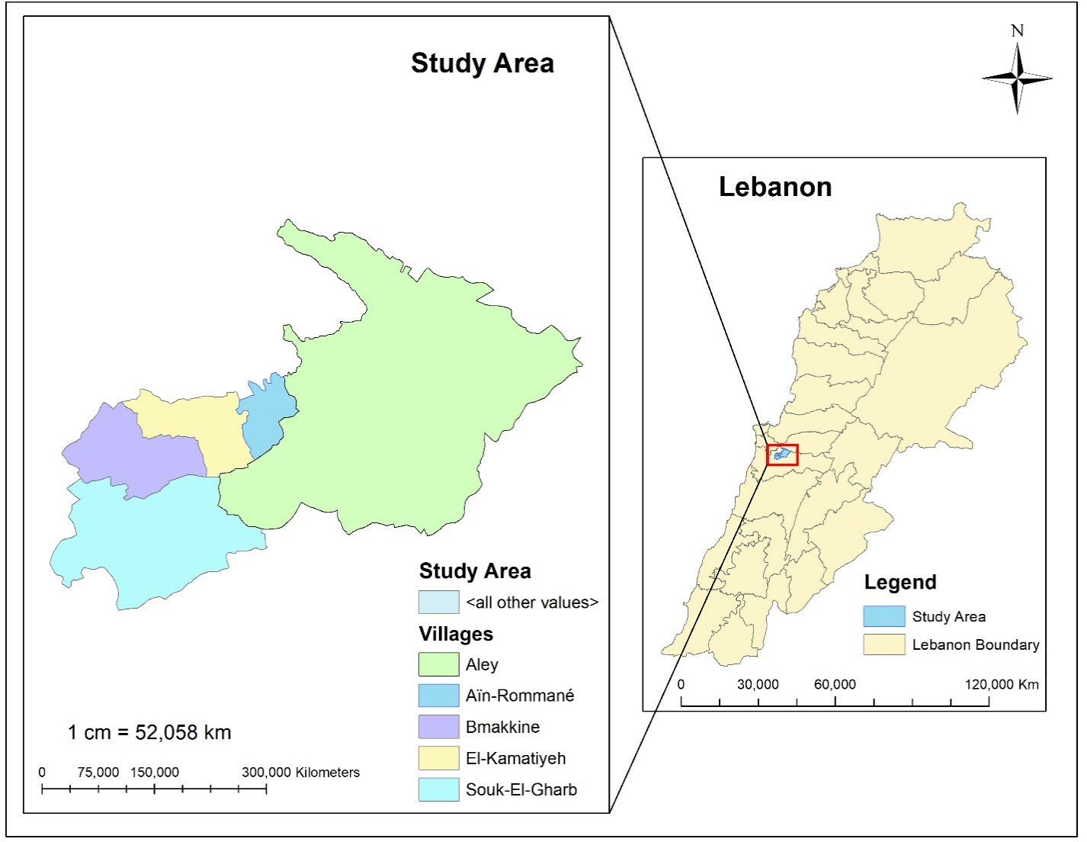

Slide 23
LUCC results using Corine classification at level 4

Slide 24
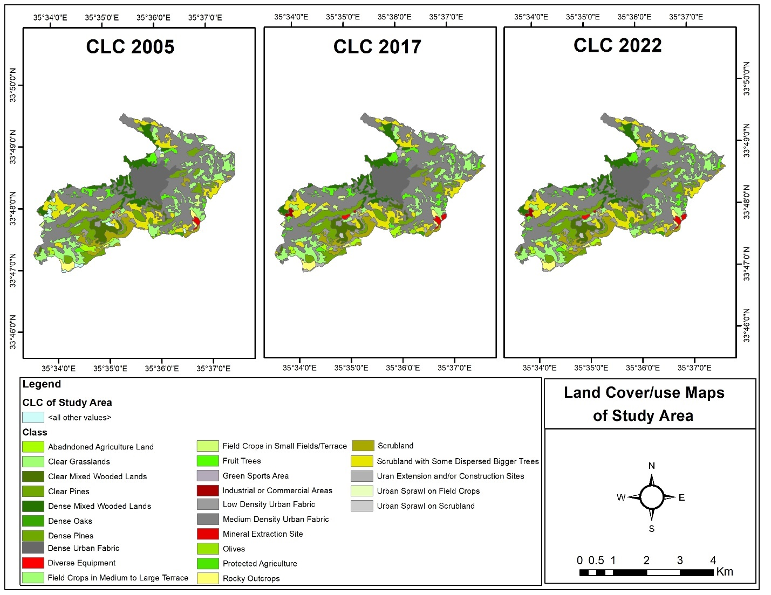

Slide 25
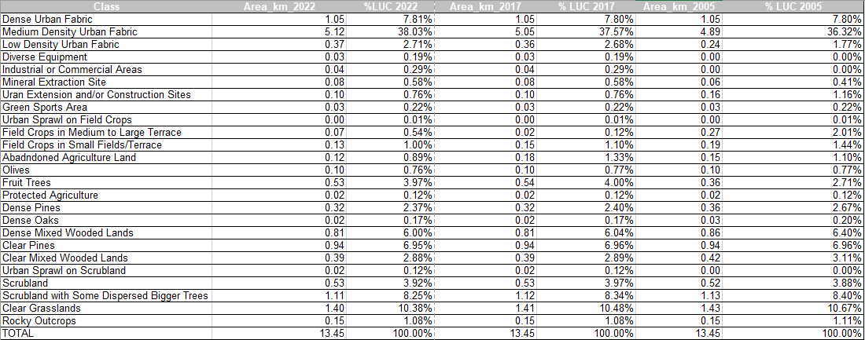

Slide 26
LUCC results using Corine classification at level 1

Slide 28
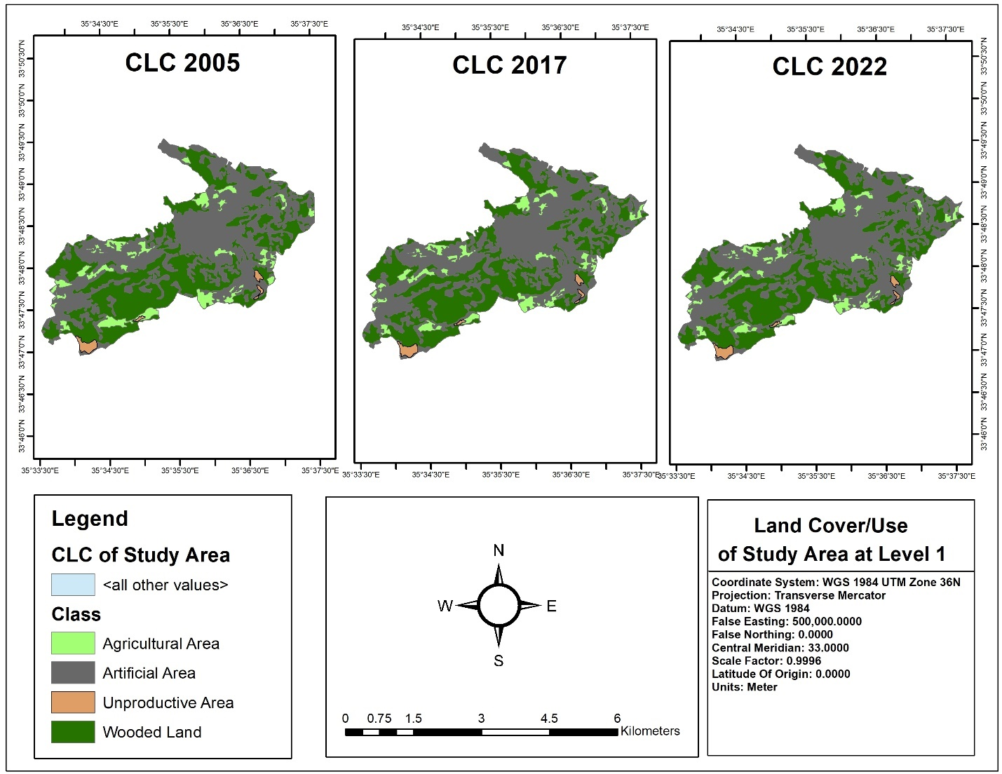

Slide 29
LUCC RESULTS OF EACH VILLAGE

Slide 33
lucc results using supervised classification at level 1
CLASS | Area 2005 | (%) 2005 | Area 2017 | (%) 2017 | Area 2021 | (%) 2021
Agricultural Area | 2.01 | 14.99% | 1.92 | 14.32% | 1.69 | 12.59%
Artificial Area | 6.49 | 48.30% | 6.72 | 50.04% | 6.66 | 49.61%
Unproductive Area | 0.51 | 3.76% | 0.73 | 5.44% | 0.80 | 5.94%
Wooded Land | 4.42 | 32.94% | 4.06 | 30.19% | 4.28 | 31.86%
Total | 13.43 | 100.00% | 13.43 | 100.00% | 13.43 | 100.00%

Slide 35
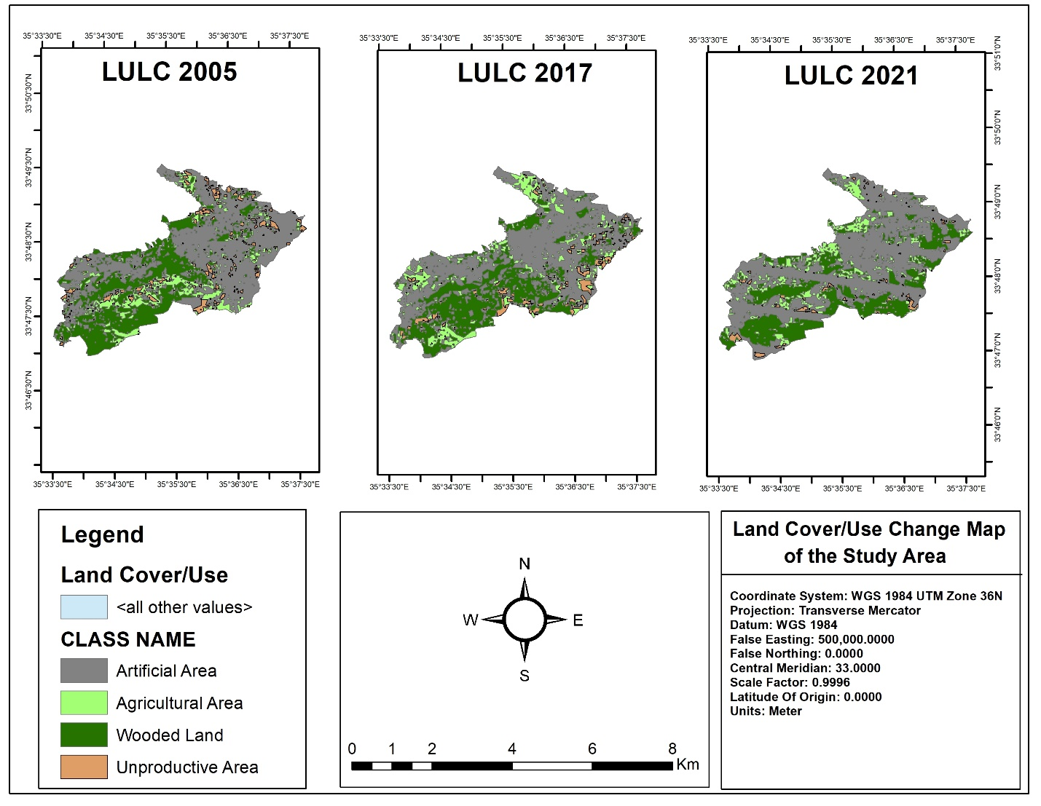
LUCs of Study Area using Supervised Classification

Slide 36
comparison between corine and supervised classification

Slide 40
conclusion
CHANGES IN DIFFERENT LAND USE/LAND COVER:
It is affirmed that:
The mining activities.
Migration of people from other villages into the area.
and the human pressure on forest for firewood as well as grazing of cattle in the forested area led to the change in the natural topography of the region.
With the advent of above reasons, considerable portion of the wooded land was converted to non- forest area such as settlement, roads and grasslands.
Most of the dense forest areas and agricultural fields were converted into mining areas and settlement areas.
Thus, the increase in mining and settlement areas can be attributed to the decrease in dense forest and agricultural land.
Increase in mining activities caused increase in settlement by migration of people into the area.

Slide 41
Conclusion (Cont)’
Comparison between clc and supervised classification:
The comparison demonstrated in this article shows its success in certain positions, and highlights its weak points.
Comparison between CORINE classification and supervised classification at level one is the most effective and safe, since it bands together most of the classes.
The comparison between the two system fails in some positions when the resolution of the satellite imageries is different.
More realistic comparison could happen only if we have same satellite imageries having same resolution and have been taken within the same year.

Slide 42
THANK YOU

